Slide 1
Hash Tables and Hash Maps
ITSC 2214 Data Structures & Algorithms
UNC Charlotte

Slide 2
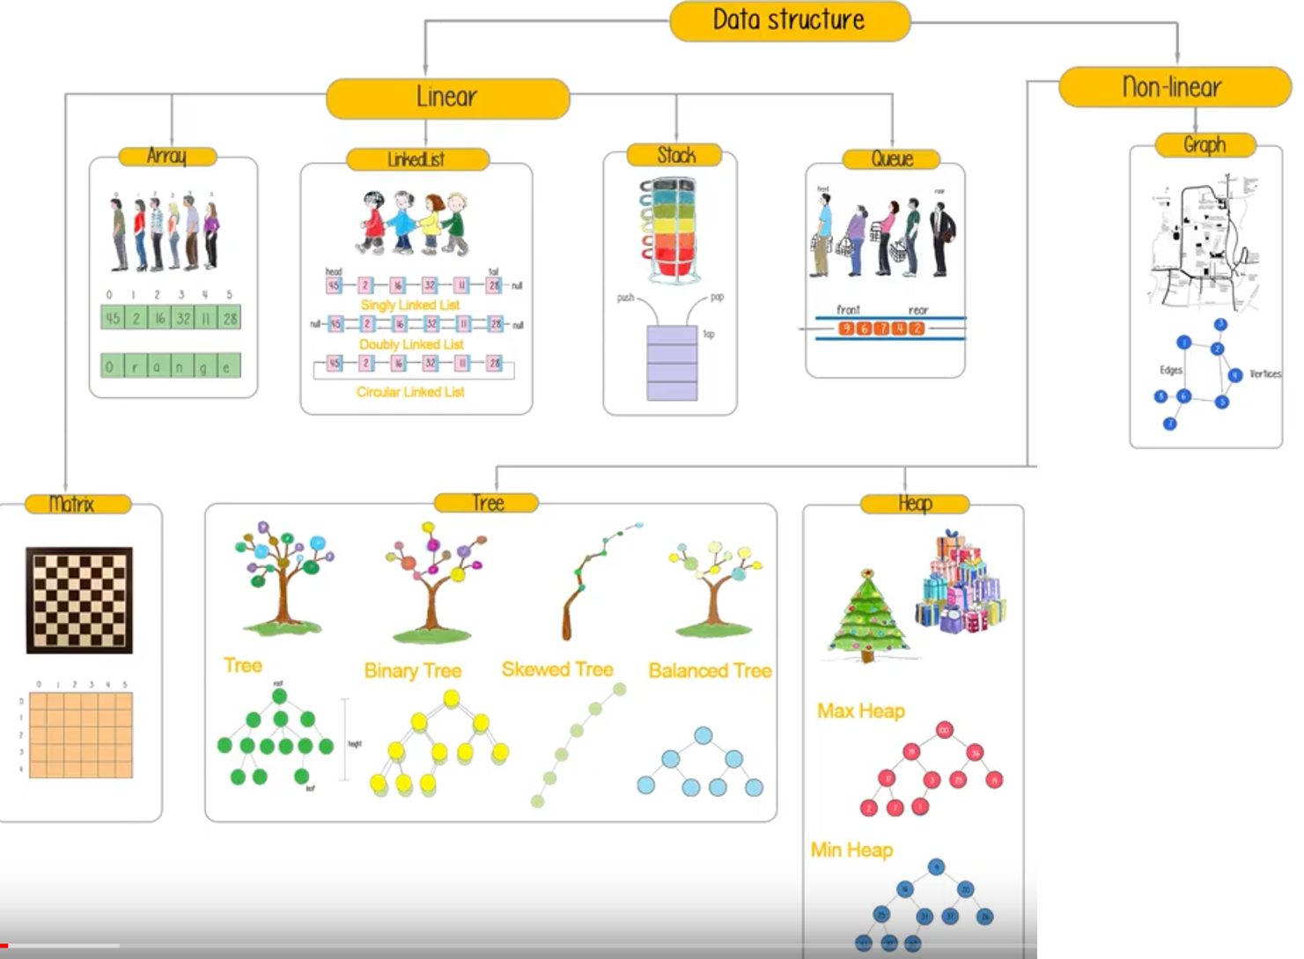
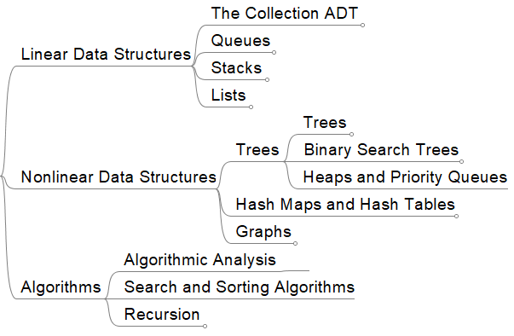

Slide 3
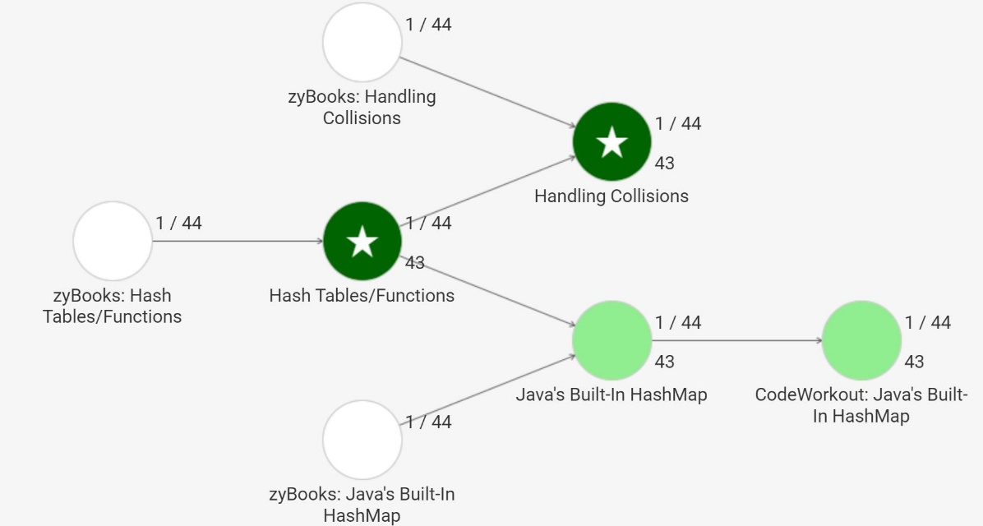
Prepwork Progress
63
92%
62
90%
66
65
90%
92%
60
54
86%
87%
62
85%

Slide 5

Notes:
Poll Title: Hash tables and hash maps https://www.polleverywhere.com/competitions/CXcaZoh9ykxEuJ1g2TRic?display_state=welcome&controls=none&onscreen=persist

Slide 6

Notes:
Poll Title: A perfect (or direct) hash function requires: https://www.polleverywhere.com/multiple_choice_polls/W9FGhOTw4DyRWQDPDzmtq?display_state=title&controls=none&onscreen=persist

Slide 7
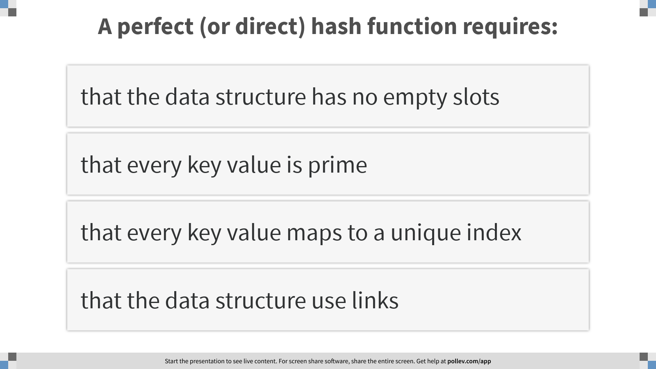
Notes:
Poll Title: A perfect (or direct) hash function requires: https://www.polleverywhere.com/multiple_choice_polls/W9FGhOTw4DyRWQDPDzmtq?display_state=instructions&controls=none&onscreen=persist

Slide 8
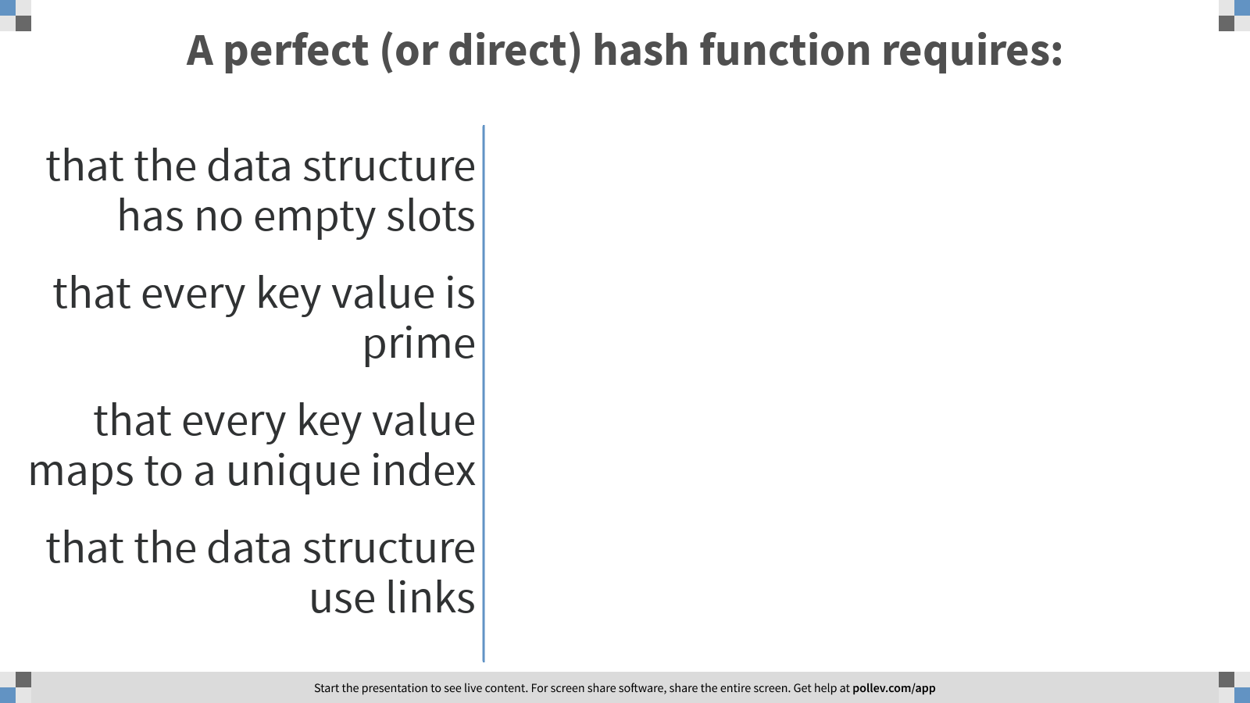
Notes:
Poll Title: A perfect (or direct) hash function requires: https://www.polleverywhere.com/multiple_choice_polls/W9FGhOTw4DyRWQDPDzmtq?display_state=chart&display=correctness&controls=none&onscreen=persist

Slide 9

Notes:
Poll Title: Hash tables and hash maps https://www.polleverywhere.com/competitions/CXcaZoh9ykxEuJ1g2TRic?display_state=leaderboard&onscreen=persist

Slide 10
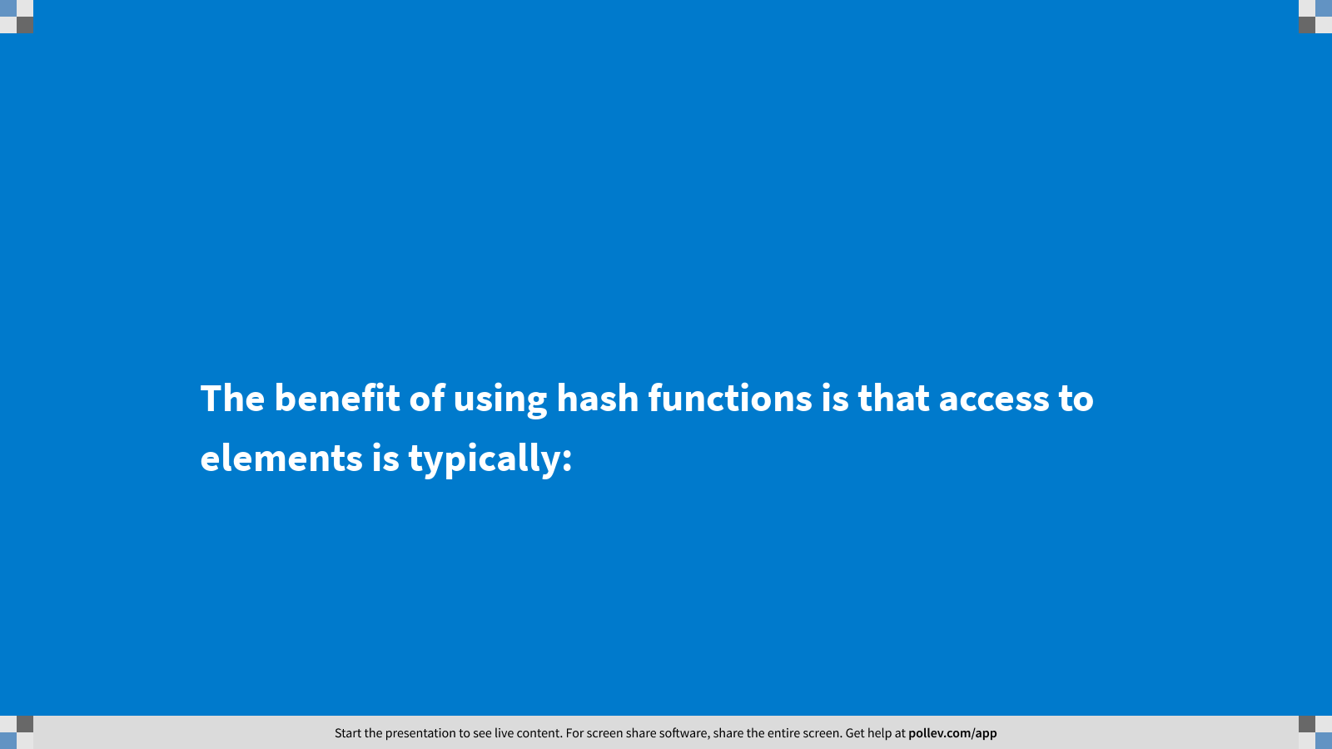
Notes:
Poll Title: The benefit of using hash functions is that access to elements is typically: https://www.polleverywhere.com/multiple_choice_polls/YFGY6665ADHrn5V4dbMR0?display_state=title&controls=none&onscreen=persist

Slide 11
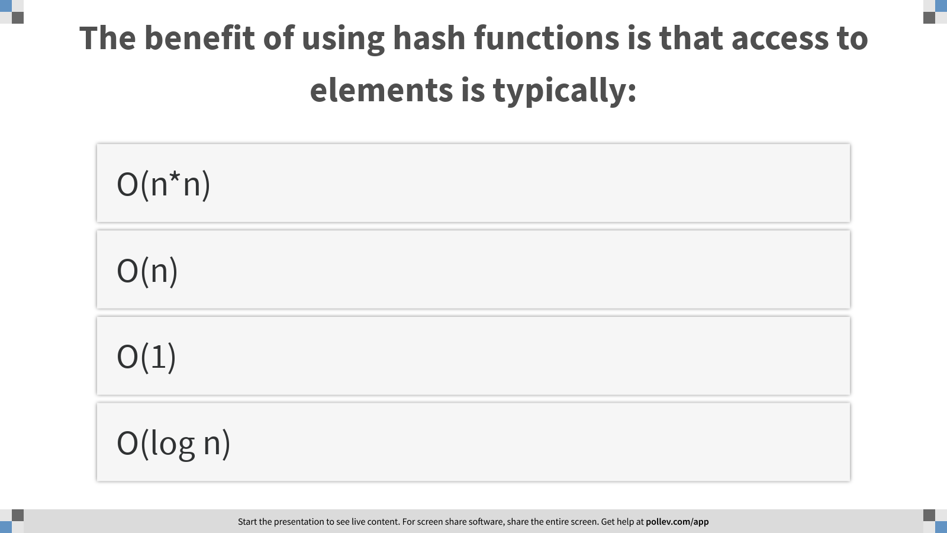
Notes:
Poll Title: The benefit of using hash functions is that access to elements is typically: https://www.polleverywhere.com/multiple_choice_polls/YFGY6665ADHrn5V4dbMR0?display_state=instructions&controls=none&onscreen=persist

Slide 12
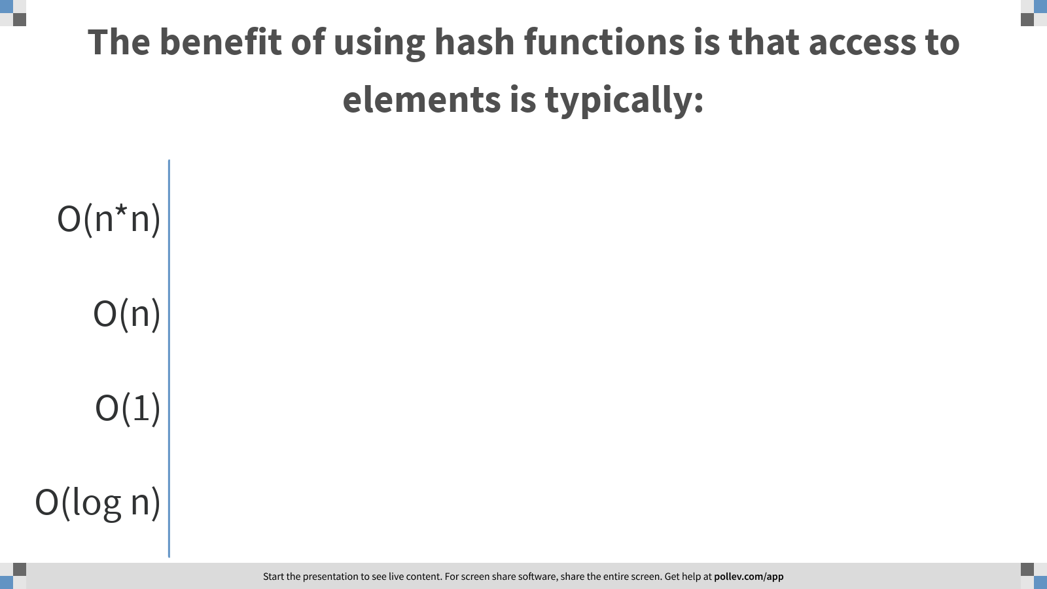
Notes:
Poll Title: The benefit of using hash functions is that access to elements is typically: https://www.polleverywhere.com/multiple_choice_polls/YFGY6665ADHrn5V4dbMR0?display_state=chart&display=correctness&controls=none&onscreen=persist

Slide 13
Notes:
Poll Title: Hash tables and hash maps https://www.polleverywhere.com/competitions/CXcaZoh9ykxEuJ1g2TRic?display_state=leaderboard&onscreen=persist

Slide 14
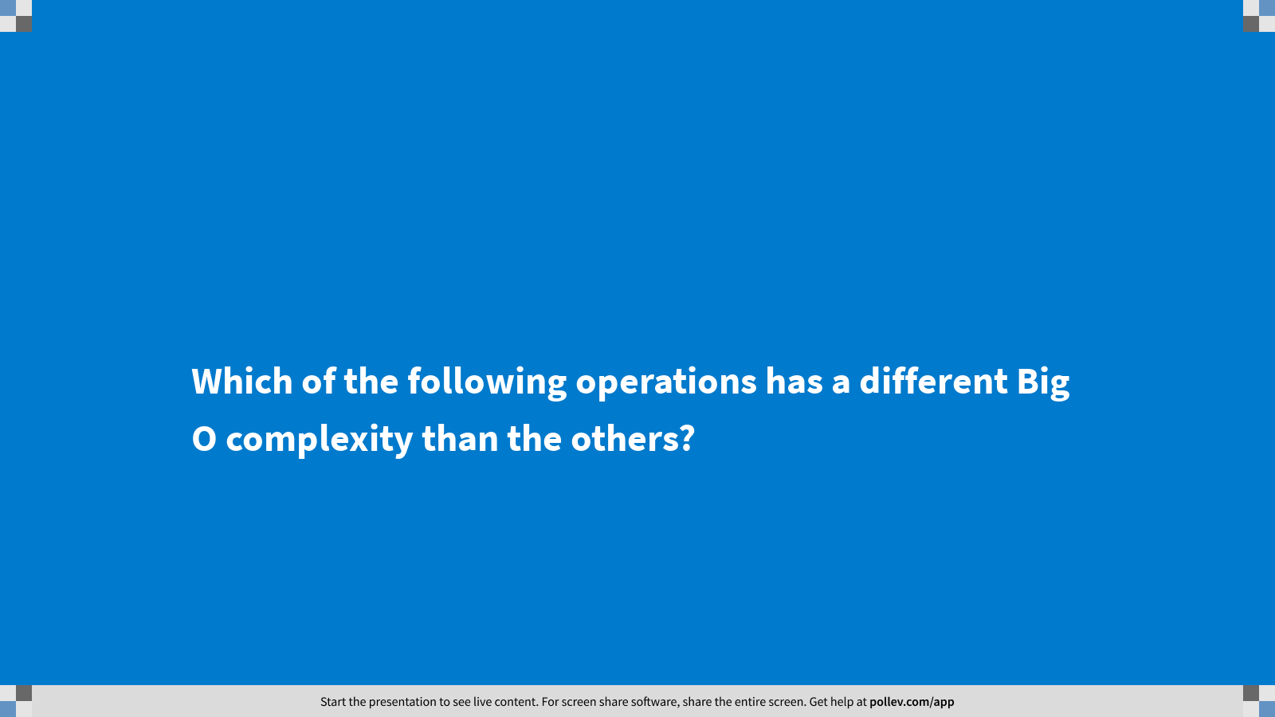
Notes:
Poll Title: Which of the following operations has a different Big O complexity than the others? https://www.polleverywhere.com/multiple_choice_polls/q8z0zbLXzTyqc4K07wVzt?display_state=title&controls=none&onscreen=persist

Slide 15
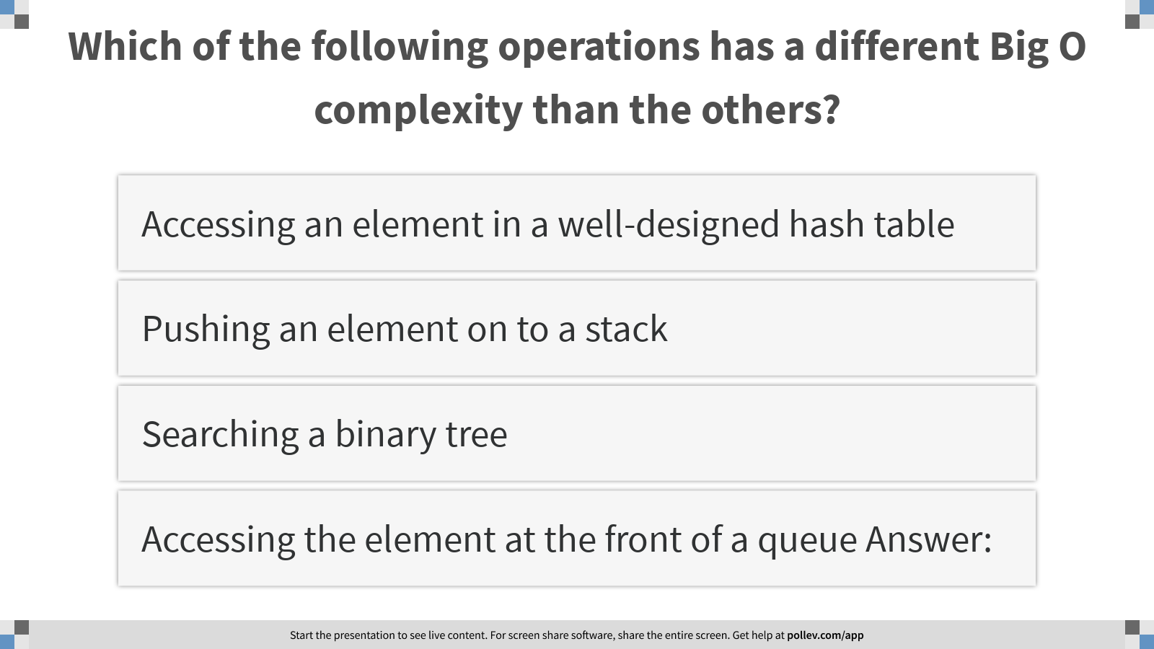
Notes:
Poll Title: Which of the following operations has a different Big O complexity than the others? https://www.polleverywhere.com/multiple_choice_polls/q8z0zbLXzTyqc4K07wVzt?display_state=instructions&controls=none&onscreen=persist

Slide 16
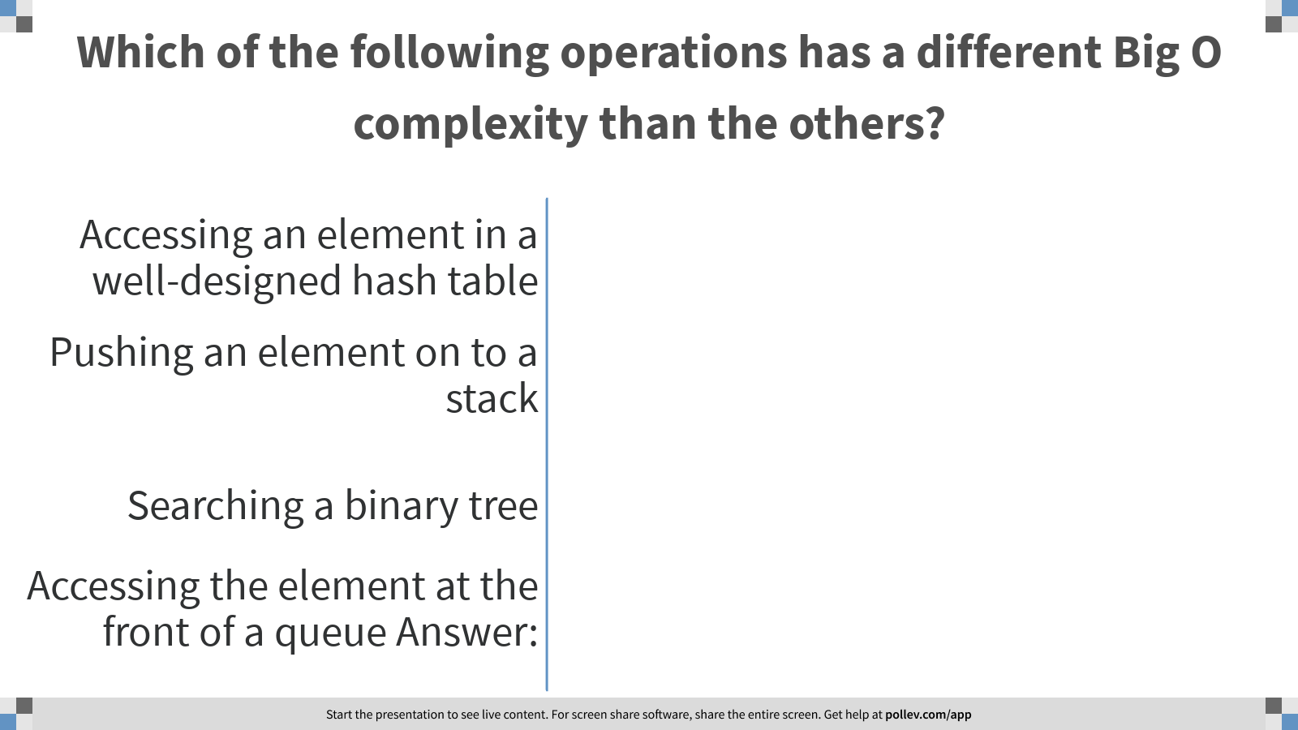
Notes:
Poll Title: Which of the following operations has a different Big O complexity than the others? https://www.polleverywhere.com/multiple_choice_polls/q8z0zbLXzTyqc4K07wVzt?display_state=chart&display=correctness&controls=none&onscreen=persist

Slide 17

Notes:
Poll Title: Hash tables and hash maps https://www.polleverywhere.com/competitions/CXcaZoh9ykxEuJ1g2TRic?display_state=finale&onscreen=persist

Slide 18
Every data structure has its own special characteristics

Slide 19
Arrays vs Linked Lists
Recall that arrays store elements as an ordered collection of a sing data type in adjacent locations, where each element is associated with an index or location. We could access an element at a random location in a constant runtime by using subscript.
The drawback of an array is that the array size is fixed. Since array elements stay in adjacent locations, it requires us to declare array size before we compile and execute our code, which lets operating system to reserve a block of memory large enough to hold adjacent elements.
Linked lists also store items as an ordered collection but they do not require a fixed size in the data collection. The price that we pay for an expandable size is the random access to any element in a constant time. In a linked list, we need a linear runtime in locate an element, since a traversal in the list is required.

Slide 20
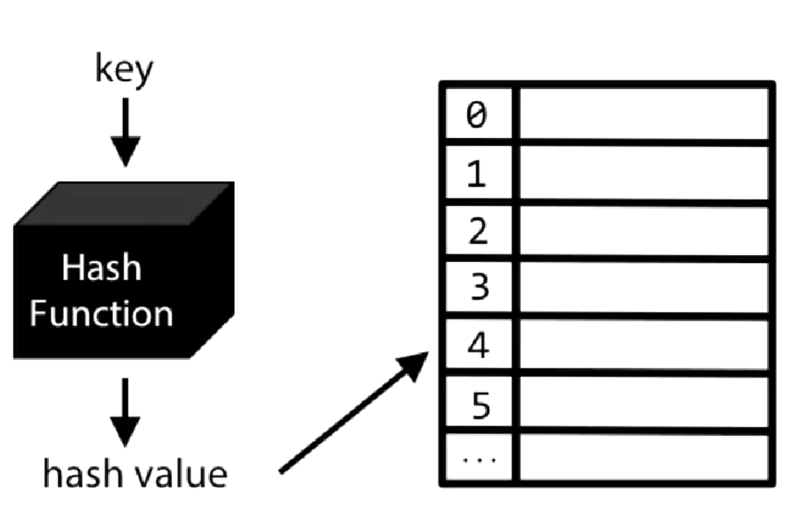
Every data structure has its own special characteristics
What is the time complexity in search for an item in an unsorted list?
What is the time complexity in search for an item in a sorted list? A BST is used when quick searching of an element (in log(n)) is required.
How can we design a data structure, which can grow with more data coming and where searching (or inserting / removing) an item may require only O(1)?
Notes:
Every data structure has its own special characteristics
a BST is used when quick searching of an element (in log(n)) is required. A heap or a priority queue is used when the minimum or maximum element needs to be fetched in constant time. Similarly a hash table is used to fetch, add and remove an element in constant time.

Slide 21
Hash Tables
A hash table is a data structure that stores unordered items by mapping (or hashing) each item to a bucket location in an (bucket) array (or vector). Namely, a hash table consists of
- an array, where each hash table array element called a bucket holds a data item represented by its key,
- a hash function, which maps the item key to a bucket index so that an item can be inserted/removed/searched through the bucket index
A hash table's main advantage is that searching (or inserting / removing) an item may require only O(1), in contrast to O(N) for searching a list or to O(log N) for binary search.

Slide 22
Terms
Key
In a hash table, an item's key is the value used to map to an index. The key is the representation of the item, which distinguish itself from any other items. The key should be unique, and it could be a property of the item or the combination of properties of the item. Item in hashtable consists of a pair of key and value.
Bucket
Each hash table array element is called a bucket.
Hash function
A hash function computes a bucket index from the item's key.
Modulo operator %: A common hash function uses the modulo operator %, which computes the integer remainder when dividing two numbers. Ex: 23 % 10 is 3, 23 % 100 is 23, 23 % 22 is 1. A % b = A – (A/b) * b, / integer division

Slide 23
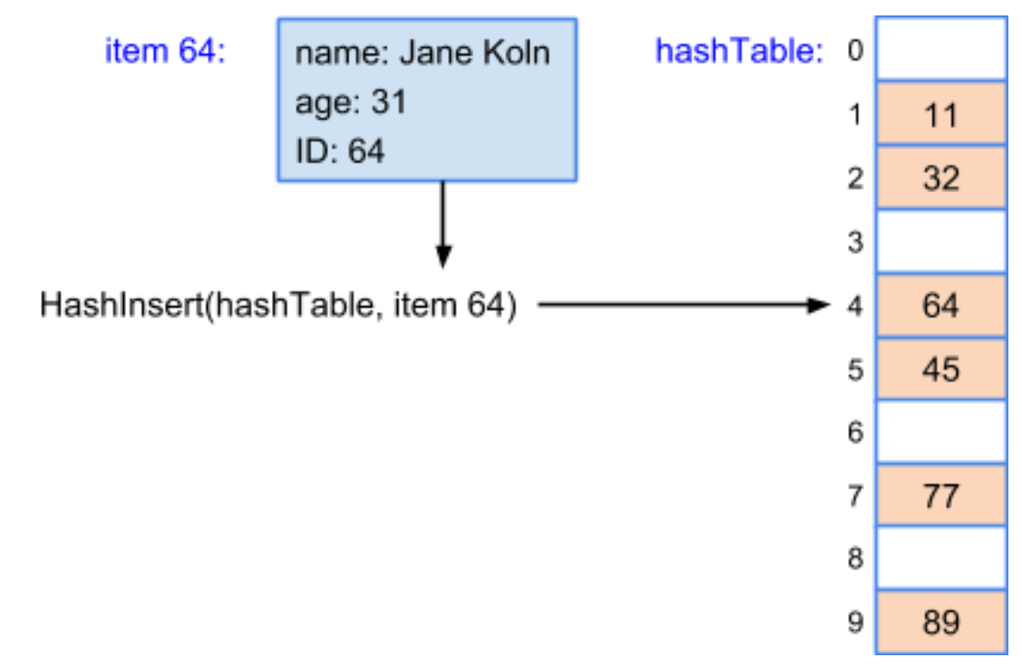
Item representation
Normally, each item being stored is an object with several fields, such as a person object having a name, age, and ID number, with the ID number used as the key. For simplicity, this section represents an item just by the item's key. Ex: Item 64 represents a person object with a key of 64, which is the person's ID. HashInsert(hashTable, item 64) inserts item 64 in bucket 4, representing item 64 in the hash table just by the key 64.

Slide 24
Direct Hashing
A direct access table has the advantage of no collisions: each key is unique (by definition of a key), and each gets a unique bucket, so no collisions can occur. However, a direct access table has two main limitations.
All keys must be non-negative integers, but for some applications keys may be negative.
The hash table's size equals the largest key value plus 1, which may be very large.

Slide 25
Direct Hash
A direct hash function uses the item's key as the bucket index.

Slide 26
Collision
A collision occurs when an item being inserted into a hash table maps to the same bucket as an existing item in the hash table.
Equal keys must have the same hash, however, different keys can have the same hash. If two different keys have the same hash, the two values belonging to them will be stored in the same bucket. Inside a bucket, values are stored in a list and retrieved by looping over all elements. The cost of this is O(n).

Slide 27
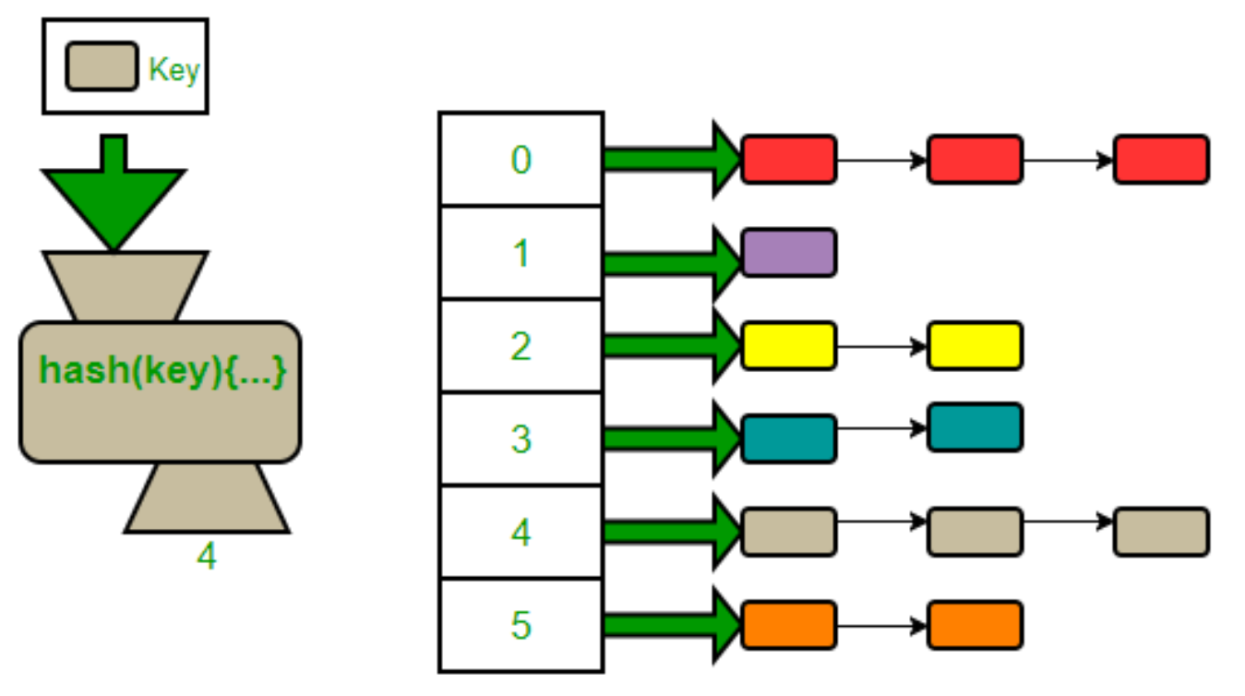
Chaining
Chaining is a collision resolution technique where each bucket has a list of items, where each list may store multiple items that map to the same bucket. The insert operation first uses the item's key to determine the bucket, and then inserts the item in that bucket's list. Searching also first determines the bucket, and then searches the bucket's list. Likewise for removes.

Slide 28
bucketArray
HashMap<Integer, String> dict = new HashMap<>(100);
dict
0
Assume we’re mapping employee numbers and names and that the hash value is determined by the mod operator applied to the employee number. That is, the remainder when the employee number is divided by 100 is the element index of the hash table where the number/name data is stored.
1
2
3
…
…
9
10
11
…
…
96
97
98
99

Slide 29
dict.put(1000, “celine”);
bucketArray
1000/100 = 10 R0
1000%100 = 0
dict
key data next
0
1000, celine, null
1
2
3
…
…
9
10
11
…
…
96
97
98
99

Slide 30
dict.put(1110, “myron”);
bucketArray
1110/100 = 11 R10
1110%100 = 10
dict
key data next
0
1000, celine, null
1
2
3
…
…
9
10
1110, myron, null
11
…
…
96
97
98
99

Slide 31
dict.put(1102, “connor”);
bucketArray
1102/100 = 11 R2
1102%100 = 2
dict
key data next
0
1000, celine, null
1
2
1102, connor, null
3
…
…
9
10
1110, myron, null
11
…
…
96
97
98
99

Slide 32
dict.put(1200, “joshua”);
bucketArray
1200/100 = 12 R0
1200%100 = 0
dict
key data next
1000, celine, null
0
1200, joshua,
1
2
1102, connor, null
3
…
…
9
10
1110, myron, null
11
…
…
96
97
98
99

Slide 33
dict.put(1400, “stephen”);
bucketArray
1400/100 = 14 R0
1400%100 = 0
dict
key data next
1400, stephen, null
1000, celine, null
0
1200, joshua, null
1
2
1102, connor, null
3
…
…
9
10
1110, myron, null
11
…
…
96
97
98
99

Slide 34
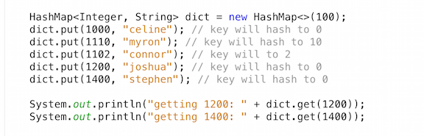
What will be names output by the following:
A. celine
celine
B. celine
Joshua
C. stephen
Joshua
D. joshua
stephen

Slide 35
dict
bucketArray
0
1400, stephen, null
1200, joshua, null
1000, celine, null
1
2
1102, connor, null
3
…
…
9
10
1110, myron, null
11
…
…
96
97
98
99
1200%100 = 0 so start at element 0 and follow the links until 1200 is located then print “joshua”
1400%100 = 0 so start at element 0 and follow the links until 1400 is located then print “stephen”

Slide 36
Example
Let us assume that each item is identified by its number in the item variable name. Given hash function of key % 10, draw the hash table of resolving collision by chaining techniques after the indicated operation(s). Assume items are inserted at the end of a bucket's list. Show the specified bucket's list for each operation.
dict
0
1
2
3
HashInsert(table, item77)
HashInsert(table, item30)
HashInsert(table, item17)
HashSearch(table, 77)
HashInsert(table, item5)
HashInsert(valsTable, item20)
HashInsert(valsTable, item23)
HashInsert(valsTable, item97)
HashRemove(valsTable, item17)
…
…
9
Questions:
Bucket 0's list: ___ Bucket 3's list: ___ Bucket 5's list: ___ Bucket 7's list: ___ How many list elements are compared for HashSearch(valsTable, item67)?
___ __
10
11
…
…
96
97
98
99

Slide 37
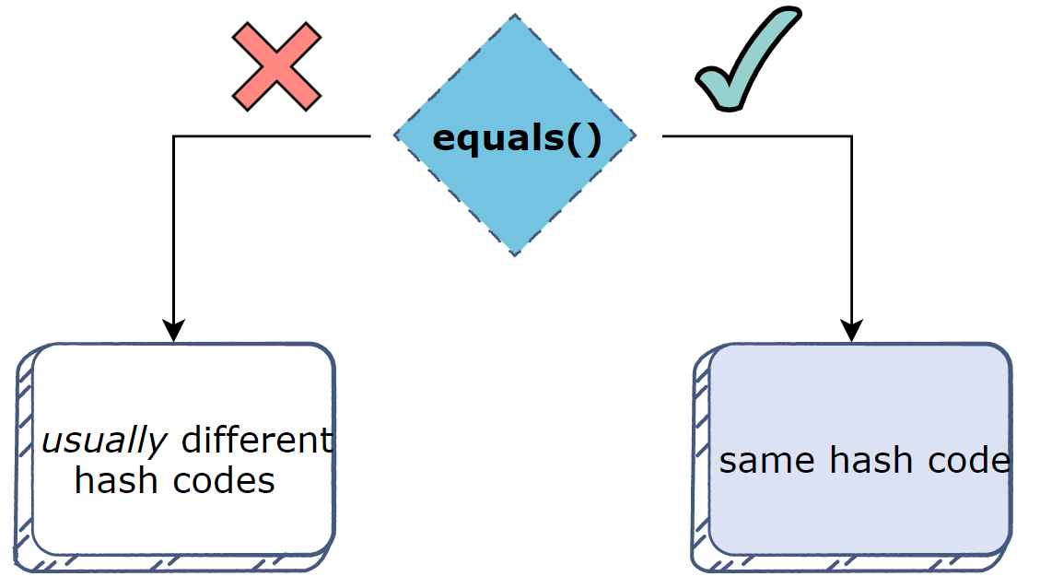
The hashCode()
class Hash{
public static void main(String[] args){
String a = "200";
String b = "200";
if(a.equals(b)){
System.out.println("Equal variables:");
System.out.println(a.hashCode() + "\n" + b.hashCode());
}
String c = "10";
String d = "50";
if(!c.equals(d)){
System.out.println("\nUn-equal variables:");
System.out.println(c.hashCode() + "\n" + d.hashCode());
}
}
}
Equal variables:
49586
49586
Un-equal variables:
1567
1691

Slide 38
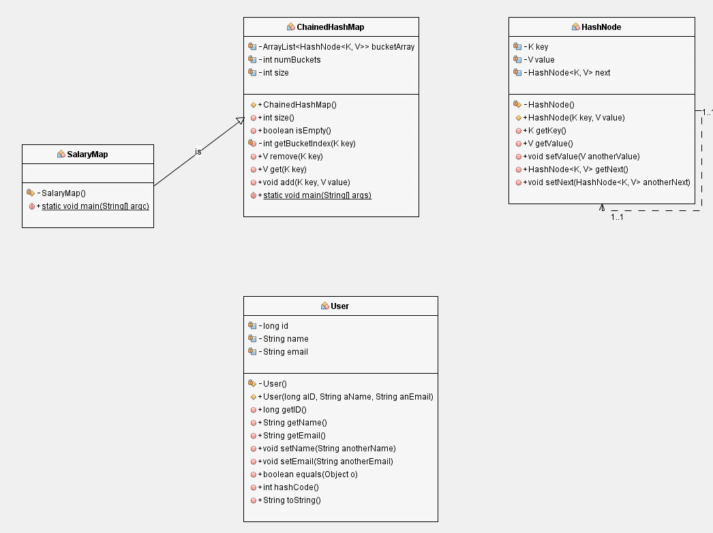
Lab:

Slide 39
Open addressing (also called linear probing)
Open addressing is a collision resolution technique where collisions are resolved by looking for an empty bucket elsewhere in the table.

Slide 40
Example
Let us assume that each item is identified by its number in the item variable name. Given hash function of key % 10, draw the hash table of resolving collision by linear probing techniques after the indicated operation(s). Assume items are inserted at the end of a bucket's list.
dict
0
1
2
HashInsert(table, item77)
HashInsert(table, item30)
HashInsert(table, item17)
HashSearch(table, item77)
HashInsert(table, item5)
HashInsert(valsTable, item20)
HashInsert(valsTable, item23)
HashInsert(valsTable, item97)
HashRemove(valsTable, item17)
3
…
…
9
Questions:
Draw and demonstrate what could be in the hash table?
___ __
How many list elements are compared for HashSearch(valsTable, item67)?
___ __
10
11
…
…
96
97
98
99

Slide 41
Java build-in HashMap
The Map interface within the Java Collections Framework defines a Collection that associates (or maps) keys to values.
A hash map uses the hashing technique to store and manage "key/value" pairs.
One object is used as a key (index) to another object (value). It can store different types: String keys and Integer values, or the same type, like: String keys and String values.

Slide 42
Java Built-in HashMap
Hashing is a fundamental concept of computer science
hashCode() returns an integer value, generated by a hashing algorithm.
Objects that are equal (according to their equals()) must return the same hash code. It's not required for different objects to return different hash codes.
HashMap<K, V> is a part of Java’s collection since Java 1.2. This class is found in java.util package. It provides the basic implementation of the Map interface of Java. It stores the data in (Key, Value) pairs, and you can access them by an index of another type (e.g. an Integer). One object is used as a key (index) to another object (value).

Slide 43
Hashtable versus HashMap in Java
Hashtable and HashMap are quite similar – both are collections that implement the Map interface.
The put(), get(), remove(), and containsKey() methods provide constant-time performance O(1). Internally, these methods work based on a general concept of hashing using buckets for storing data.
Neither class maintains the insertion order of the elements. In other words, the first item added may not be the first item when we iterate over the values.
Hashtable doesn't allow null at all.
HashMap allows adding one Entry with null as key as well as many entries with null as value.
We should use HashMap for an unsynchronized or single threaded application.
It is worth mentioning that since JDK 1.8, Hashtable has been deprecated. However, ConcurrentHashMap is a great Hashtable replacement. We should consider ConcurrentHashMap to use in applications with multiple threads.

Slide 44
Common HashMap methods

Slide 45
put() | put(key, value) Associates key with specified value. If key already exists, replaces previous value with specified value. | // Map originally empty exMap.put("Tom", 14); // Map now: Tom->14, exMap.put("John", 86); // Map now: Tom->14, John->86
putIfAbsent() | putIfAbsent(key, value) Associates key with specified value if the value does not already exist. | // Assume Map is: Tom->14, John->86 exMap.putIfAbsent("Tom", 20); // Key "Tom" already exists. Map is unchanged. exMap.putIfAbsent("Mary", 13); // Map is now: Tom->14, John->86, Mary->13
get() | get(key) Returns the value associated with key. If key does not exist, return null. | // Assume Map is: Tom->14, John->86, Mary->13 exMap.get("Tom") // returns 14 exMap.get("Bob") // returns null
containsKey() | containsKey(key) Returns true if key exists, otherwise returns false. | // Assume Map is: Tom->14, John->86, Mary->13 exMap.containsKey("Tom") // returns true exMap.containsKey("Bob") // returns false

Slide 46
containsValue() | containsValue(value) Returns true if at least one key is associated the specified value, otherwise returns false. | // Assume Map is: Tom->14, John->86, Mary->13 exMap.containsValue(86) // returns true (key "John" associated with value 86) exMap.containsValue(17) // returns false (no key associated with value 17)
remove() | remove(key) Removes the map entry for the specified key if the key exists. | // Assume Map is: Tom->14, John->86, Mary->13 exMap.remove("John"); // Map is now: Tom->14, Mary->13
clear() | clear() Removes all map entries. | // Assume Map is: Tom->14, John->86, Mary->13 exMap.clear(); // Map is now empty

Slide 47
keySet() | keySet() Returns a Set containing all keys within the map. | // Assume Map is: Tom->14, John->86, Mary->13 keys = exMap.keySet(); // keys contains: "Tom", "John", "Mary"
values() | values() Returns a Collection containing all values within the map. | // Assume Map is: Tom->14, John->86, Mary->13 values = exMap.values(); // values contains: 14, 86, 13

Slide 48
Codeworkout- Java's HashMap 1
Octavia has given you a list of movies. She is tired of deciding what to watch by name and now wants to be able to pick them by the length of the title. Organize this list of movies for Octavia! The movies will be given as an array of strings. A Hash Map will need to be declared that keys each value in the array based on the length of each string.
Example:
"Double Down" keys to 11
"I am Here, Now" keys to 14
"Fateful Findings" keys to 19
"Pass Thru" keys to 9
Java's built in Hash Map is enabled for this problem. The API can be viewed here: https://docs.oracle.com/javase/8/docs/api/java/util/HashMap.html
Sample:
public HashMap<Integer, String> buildMap(String[] s)
Notes:
HashMap<Integer, String> map = new HashMap<Integer, String>();
for (String txt : s){
map.put(txt.length(), txt);
}
return map;

Slide 49
Codeworkout - Java's HashMap 2
You are in charge of keeping student records. Those records are recorded in a hash map that uses a student's ID number as the key in order to look up their name. Several typos were made when adding the last few records! Replace the names at these ID numbers and correct them:
8675309 -> Krist Novoselic
1111111 -> Chad Heartswagger
2891202 -> Lockwell Sanderson
Sample:
public HashMap<Integer, String> editMap(HashMap<Integer, String> map)
Notes:
map.replace(8675309, "Krist Novoselic");
map.replace(1111111, "Chad Heartswagger");
map.replace(2891202, "Lockwell Sanderson");
return map;

